Slide 1
District Heating Network
Manual for Data Acquisition Code
Audrey Blizard, Stephanie Stockar
11/24/2022

Slide 2
Table of Contents
Installation & Startup
Installation
Quick Start
Input Files
Main VI
Main VI
LabVIEW Overview
Structure
Global Variables
Adding additional components
Sub-Vis
Intro
Function
Structure
Peltier Control
Intro
GUI Components
Structure

Slide 3



Installation - Required Programs
This code requires three programs to be installed on the operating computer
NI LabVIEW 2020 is needed to run the data acquisition code and related sub-processes
The LabView code collects data and processes it, providing both real-time control and visualization and the ability to save the collected data.
It also allows the user to control the Peltier Junctions
The ULX for NI LabView package must be installed for the code to operate correctly
Microsoft Excel is needed to edit the Input, Calibration and Channels files
.csv files are used to pass information into the code
These files have a predesignated structure that must be followed for the code to operate correctly (see Section XX)
InstaCal is needed to configure the Omega DAQs and set the calibration parameters for the thermistors
The installation instructions for this software can be found in the ULX Quick Start Manual

Slide 4
Installation - ULX for NI LabView
To interface with the Omega DAQ used to collect thermistor data, you must add the ULX for NI LabVIEW toolbox to the current LabVIEW version
Note that ULX for NI LabView is currently only compatible with LabVIEW 2020 and earlier.
This software can be downloaded from the Omega Website: https://www.omega.com/en-us/data-acquisition/data-acquisition-modules/omb-daq-2408-series/p/OMB-DAQ-2408
The Quick Start manual for this software can be found in the OneDrive folder “DistrictHeatingNetwork\Sensor Information\Thermistors”
ULX for NI LabVIEW also requires the installation of InstaCal to operate correctly
Installation instructions can also be found the Quick Start Manual
InstaCal is where you enter the Steinhart-Hart Constants used to calibrate the thermistors in the main LabVIEW VI

Slide 5
Installation - Program Files
Download the entire folder in lab_dhn
Required files
Main Vi “DataAcquisitionCode”
Global Variables file “globalvariables”
14 sub-Vis used by the main VI. Details on these sub-vis can be found in Section 4
5 files associated with the Peltier control, starting with “TC-48-20”
3 .csv files used to pass information into the code

Slide 6
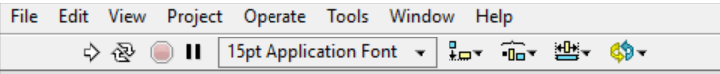
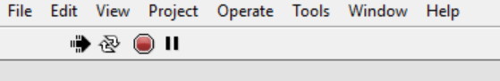
Quick Start – Running the Program
Open the main Vi “DataAcquisitionCode”
Ensure that only main file is open before starting the program
Use the White arrow located on the menu bar to start the program
At any time, the red circle can be used to abort operation of the program. However, the collected data will not be saved, and the Peltier controllers will continue running with the previously selected settings
Run
Abort

Slide 7
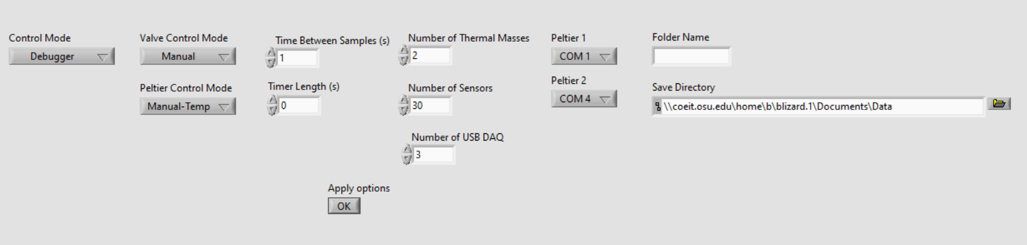
Quick Start – User Inputs
Starting the program will open a pop-up window that will allow the user to configure the data collection settings
Control Mode, Valve Control Mode, & Peltier Control Mode: Allows users to select how the code will operate, see next slide for details
Time Between Samples (s): Sets the DAQ sampling rate
Timer Length (s): Length of time for collecting data
Number of Thermal Masses: Between 1-4
Number of Sensors: Sensors being actively used, must be less than or equal to the number of sensors listed in the configuration file
Number of USB DAQ: Number of connected Omega DAQs, defaults to 3
Peltier 1 & Peltier 2: Communication ports for the Peltier Junction
Folder Name: New folder to save data files, only required for control modes that save data
Save Directory: Location for creation of new folder

Slide 8
Quick Start – Operating Modes
Control Mode
Debugger (0): Allows user to visualize data without saving it. Only stops when aborted
Manual (1): Allows user to visualize and save data in designated folder. Will only stop data acquisition manually, using the stop button
Timed (2): Allows user to visualize and save data in designated folder. Stops data acquisition after a certain time has elapsed.
Actuator Control Modes
Manual (Odd): Setpoints are entered manually by the user in real time using the main GUI
Timed (Even): Setpoints are dictated by the file “Inputs.csv” and are entered as a function of iteration number
Valve Control Mode
Position (1, 2): Control valve position directly. Valve positions are entered manually by the user
PID (3, 4): Uses PID controller to maintain a temperature setpoint in the thermal mass.
Peltier Control Mode
Temp (1, 2): Control the cold side temperature directly
Power (3, 4): Uses desired power to calculate cold side temperature
Tamb (5, 6): Uses desired simulated ambient temperature to set power and calculate cold side temperature

Slide 9
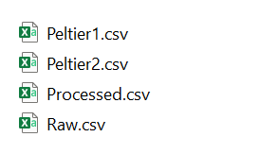
Quick Start – Save Files
If a save mode is selected, the data is saved in the user defined location
Inside the “Save Directory” set by the user in the pop-up menu, a new folder with the name set by “Folder Name” will be created
Every time the code is run 4 .csv files will be created and written to inside this folder
Peltier 1.csv: created by the Peltier 1 sub-vi, stores the Peltier 1 Sampling Time, Temp 1, Temp 2, Set Temp, and Power
Peltier 2.csv: created by the Peltier 2 sub-vi, stores the Peltier 2 Sampling Time, Temp 1, Temp 2, Set Temp, and Power
Processed.csv: Stores the processed data, converted from voltage to calibrated values, in the order specified by the “Channels.csv” file
Raw.csv: Stores the original voltage values, in the same order specified by the “Channels.csv” file

Slide 10

Input Files - Introduction
Three excel files provide LabVIEW with configuration settings
These files are loaded in programmatically and should be stored in the same folder as the main data acquisition code.
The order of the rows in these files is used during code operation, so the structure of files must remain the same
“Channels.csv”: Contains the information needed to collect data from each of the sensors and output it in the main Vi.
“Calibration.csv”: Contains calibration coefficients for each of the sensor types
“Inputs.csv”: Contains vectors of actuator control setpoint values with their corresponding execution iteration. Only used when either the valves or Peltier are set to Timed Control.

Slide 11
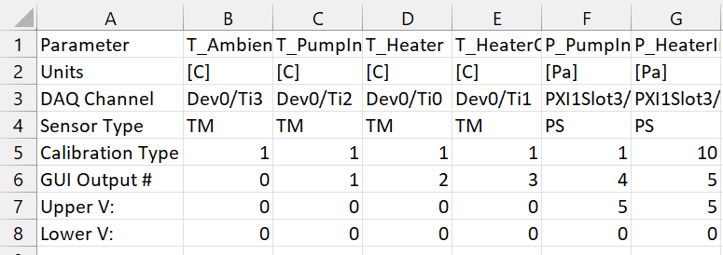
Input Files - Channels.CSV
Provides the information need to create the channels in the sensor task
Also provides the headers used in the save files, ensure that the parameter names are valid MATLAB variable names
Additional information on the sensors can be found in the OneDrive folder "DistrictHeatingNetwork\Sensor Information\Sensor Placement Guide.docx”
Details on each line can be found on the next slide

Slide 12
Input Files - Channels.CSV
Parameter: Name given by the user to each sensor. This is only used in the output file and does not directly relate to GUI naming convention
Units: Units of calibrated sensor value, only used in output files
DAQ Channel: Channel in the DAQ. The structure of each channel name is as follows:
USB DAQ: Dev#/Ti#, where the first number is the number assigned to the DAQ in InstaCal, and the second is the channel of the individual sensor
TB-4353: PXI1Slot2/ai#, where the number is individual thermocouple
BNC-2110: PXI1Slot3/ai#, where 0-15 are assigned to the first BNC block and 16-31 are assigned to the second
Sensor Type: TM-Thermistor, TC-Thermocouple, PS-Pressure sensor, MS-Mass Flow Sensor
Calibration Type: Indicates row to be used in the calibration.csv file
GUI Output #: Corresponds to the output fields in the main Vi. A table of these values can be found in the OneDrive folder "DistrictHeatingNetwork\Sensor Information\Sensor Locations.xlsx"
Upper V: Upper voltage limit the sensor can provide
Lower V: Lower voltage limit the sensor can provide

Slide 13
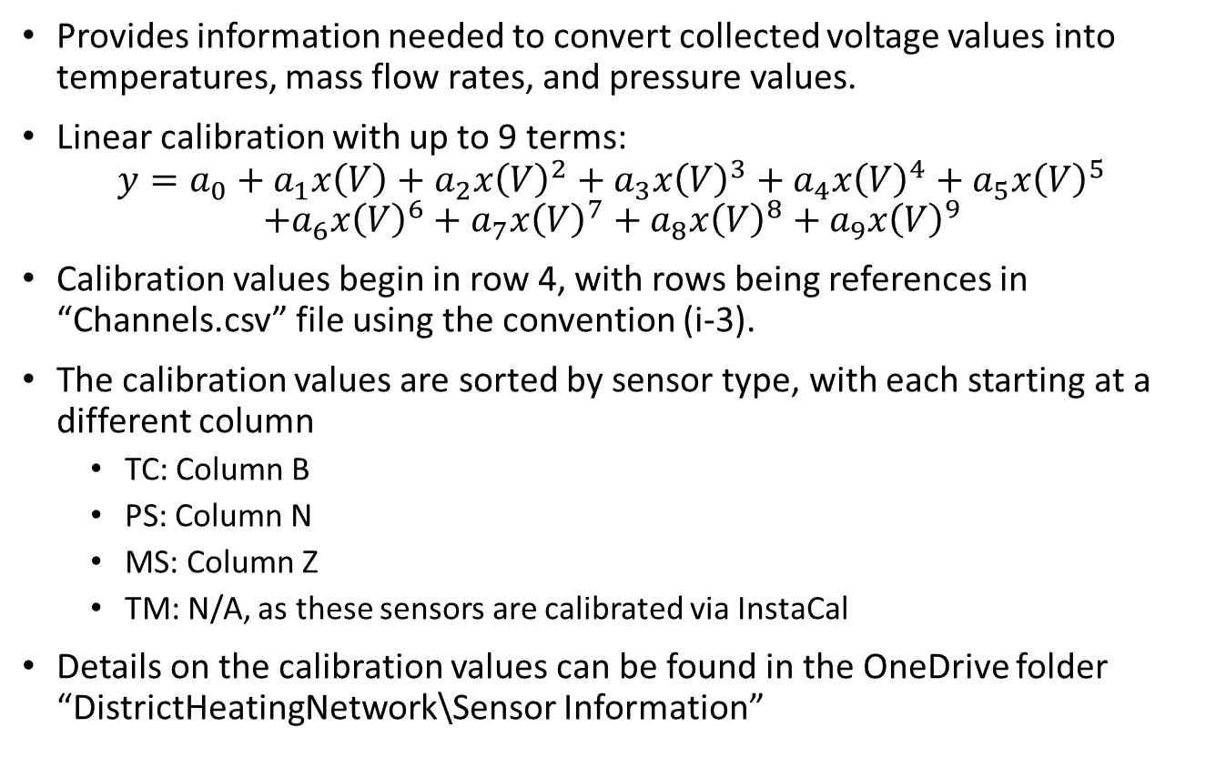
Input Files - Calibration.CSV
Provides information needed to convert collected voltage values into temperatures, mass flow rates, and pressure values.
Linear calibration with up to 9 terms:
$$y=a_{0}+a_{1}x\left(V\right)+a_{2}x{\left(V\right)}^{2}+a_{3}x{\left(V\right)}^{3}+a_{4}x{\left(V\right)}^{4}+a_{5}x{\left(V\right)}^{5}$$
$$+a_{6}x{\left(V\right)}^{6}+a_{7}x{\left(V\right)}^{7}+a_{8}x{\left(V\right)}^{8}+a_{9}x{\left(V\right)}^{9}$$
Calibration values begin in row 4, with rows being references in “Channels.csv” file using the convention (i-3).
The calibration values are sorted by sensor type, with each starting at a different column
TC: Column B
PS: Column N
MS: Column Z
TM: N/A, as these sensors are calibrated via InstaCal
Details on the calibration values can be found in the OneDrive folder “DistrictHeatingNetwork\Sensor Information”

Slide 14
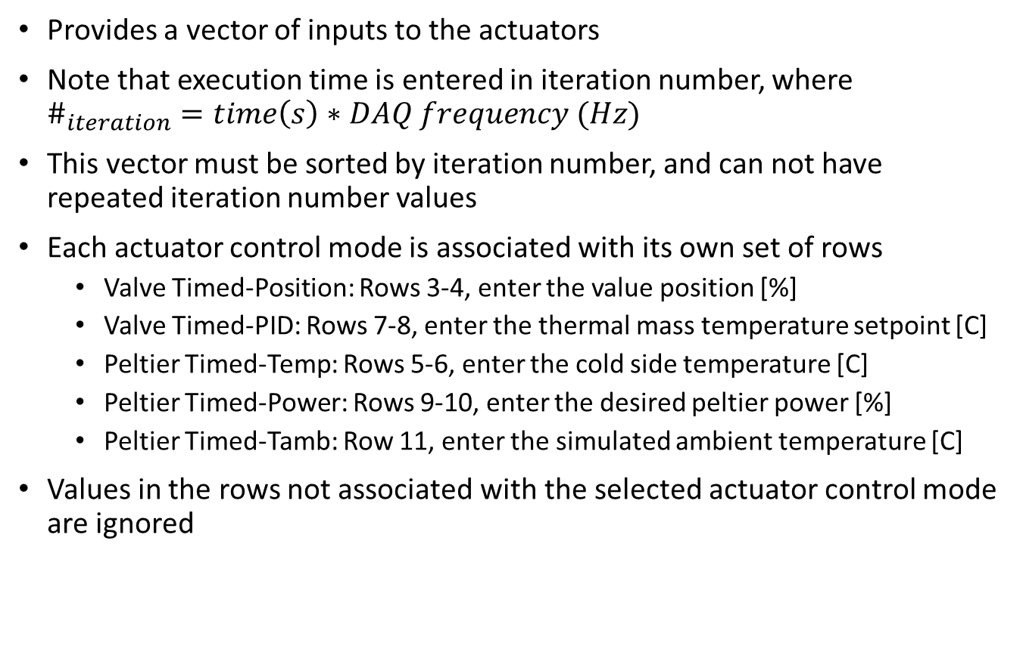
Input files - Inputs.CSV
Provides a vector of inputs to the actuators
Note that execution time is entered in iteration number, where $\#_{iteration}=time\left(s\right)∗DAQ frequency (Hz)$
This vector must be sorted by iteration number, and can not have repeated iteration number values
Each actuator control mode is associated with its own set of rows
Valve Timed-Position: Rows 3-4, enter the value position [%]
Valve Timed-PID: Rows 7-8, enter the thermal mass temperature setpoint [C]
Peltier Timed-Temp: Rows 5-6, enter the cold side temperature [C]
Peltier Timed-Power: Rows 9-10, enter the desired peltier power [%]
Peltier Timed-Tamb: Row 11, enter the simulated ambient temperature [C]
Values in the rows not associated with the selected actuator control mode are ignored

Slide 15
Main VI
The main VI “DataAcquisistionCode” has three main sections on the GUI:
Data Visualization pane (top right)
Control pane (bottom right)
Peltier pane (left)
The Data Visualization pane displays the collected data in real time
The control pane has two sections, one for the actuator controls, and one to control the data collection.
In the Peltier pane, each Peltier junction is controlled by a sub-VI, and the front panels are displayed in the main VI using subpanels

Slide 16
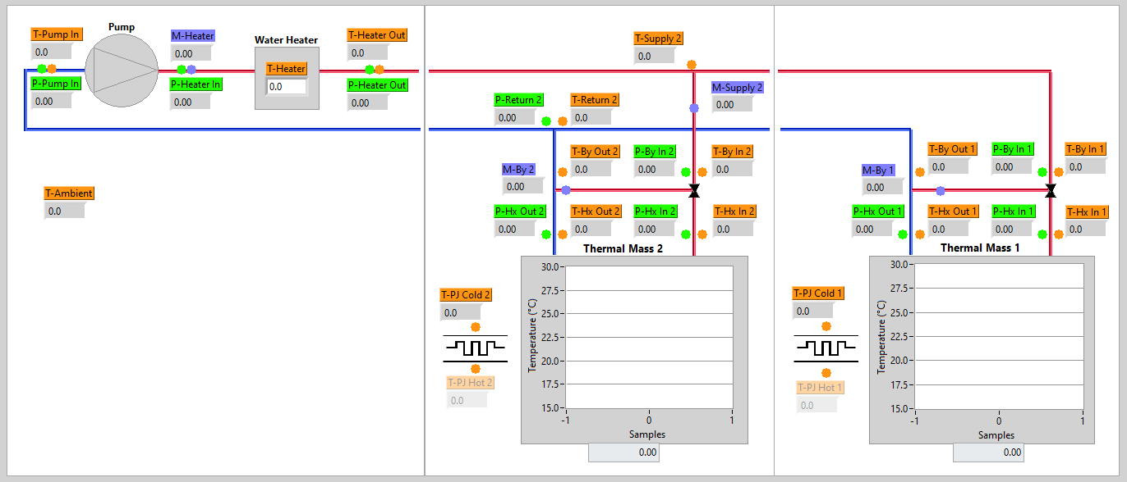
Main VI- Data Visualization
Has a built-in warning if the supply temperature exceeds 90°C
Each tabs provides data for 1 thermal mass, currently set up to accommodate up to 4 thermal masses
Thermal mass temperature is plotted as a sweep chart
Orange labels are TC and TM, purple are MS, and green are PS

Slide 17
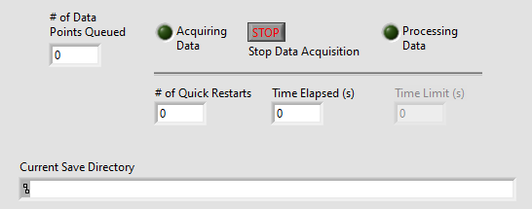
Main VI- Control pane
The data collection controls allow the user to see and control the operation of the code.
# of Data Points Queued: Number of sets of data added to the queue to be stored after data collection ends
Acquiring data: First phase of the code operation, storing data in the queue to be saved
Stop Data Acquisition: Ends the first phase of the code operation, stops collecting data, and switches to saving it to the appropriate .csv files
Processing Data: Second phase of the code, Storing data to the file
# of Quick Restarts: Number of times user run an experiment with the same configuration. Appends a number to the save folder name
Time Elapsed (s): Time elapsed in this run
Time Limit (s): Available in timed code operation, shows the set timer length

Slide 18
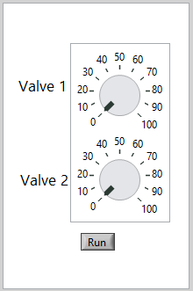
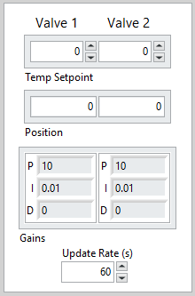
Main VI – Control Pane
Based on which Valve control mode the user selects, a different control panels is visible
Manual | PID
Either enter (Manual) or display (Timed) the desired valve positions using the dials. In Manual mode, it will not change valve position until the user clicks “Run” | In manual mode, user enters desired ThM setpoints in the top box. In timed mode, the setpoints are displayed here. The calculated valve position is displayed below. The user can also set the PID gains. The update rate dictates how often a new control command is sent to the valves.

Slide 19
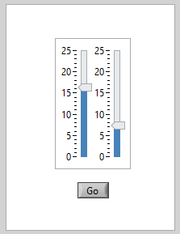
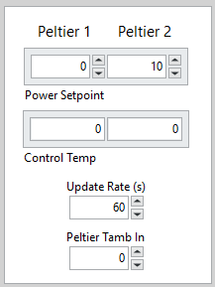
Main VI – Control Pane
Based on which Peltier control mode the user selects, a different control panels is visible
Cold Side | Power
Either enter (Manual) or displays (Timed) the desired Peltier cold side temperature using the sliders. In Manual mode, it not update the Peltier controller until the user clicks “Go” | In manual mode, user enters the desired power in the top box. In timed mode, the set powers are displayed here. In Tamb mode, the simulated ambient temperature is entered/displayed in the bottom box. The calculated necessary cold side temperature is displayed below. The update rate dictates how often a new control command is sent to the Peltier controller.

Slide 20
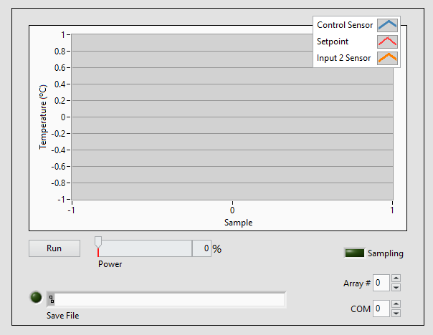
Main VI – Peltier Pane
Control Sensor: Thermocouple located on the cold side of the Peltier junction
Setpoint: Desired cold side temperature
Input 2 Sensor: Thermocouple located at the top of the ThM
Run: Turns the Peltier junction on. IMPORTANT: Stop running before ending data collection
Power: % Power output
Array #: Array location where the Peltier control variables are saved during the code operation
COM: Communication port used by the Peltier

Slide 21
LABVIEW Overview
NI LabVIEW is a block diagram-based coding language use to interface with the NI DAQ
The front panel acts as the display for the code. All outputted and inputted values are shown here in type-specific display variables
The block diagram is where the code is written
LabVIEW uses type specific variables, and each type has a different wire style
Arrays and clusters can both be used to hold groups of variables, where arrays hold variables of the same type, and clusters hold variables of different types
The code attempts to run each section as soon as all required inputs are received. Therefore, it may be necessary to wire inputs into a sequence structure or a case structure to ensure it does not execute too early. Error variables can also be used enforce order
Sub-Vis are custom blocks that can be inserted into a block diagram to call a set sub function. A sub-vi can not be called while it is already running. They are used to help keep a code compact and easy to follow. Variables on the front panels of these vis can be set to be output and input by the associated block
Global variables are used to pass information between Vis. It can be difficult to tell execution order in these variables, so make sure they are written before they are read. Global variables are particularly useful for passing values into sub-vis that are already running, and need values updated, since inputs are only taken once, when the sub-vi is first called
LabVIEW is a zero indexing program, meaning the first element is enumerated as 0. This is true in both loop and array indexing
Some sub-vis are configured as subroutines. These allow for faster code execution, at the expense of being able to probe the values during troubleshooting. This can be change by editing File -> VI Properties -> Execution -> Priority

Slide 22
Structure
While Loop 1 allows for repeating experiments once the code is started. It is exited once the user selects “No” when prompted to “Perform another test?”
For Loop 1 set to execute once. Loads the calibration parameters
While Loop 2 allows for quick restarts, where the code is restarted without changing any of the settings. It executes after For Loop 1 finishes. This loop creates the save files, queues, and tasks. Exits when the user selects “No” when asked “Would you like to Quick Restart?”
While Loop 3 starts the two Peltier control sub-vis and contains the data collection and data processing processes. Exits once the data processing is complete.
While Loop 4 controls data collection. Repeats at every time step to collect data, at the frequency set by the user. Exits when an error occurs, when the timer expires in the timed mode, or when the user presses the “stop data acquisition” button.
Sequence Structure 2 controls data processing. The first panel saves the data if there are no errors and the second shuts down the Peltier sub-vis. Exits once the data is saved and the Peltier control sub-vis are shut down.
Sequence Structure 1 gathers the user inputs and then configures the front panel based on the user selected inputs.

Slide 23
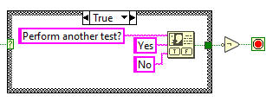
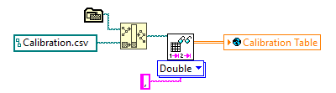
Structure
While Loop 1
Displays message to user and either restarts or terminates this loop
For Loop 1
Load Calibration parameters from file

Slide 24
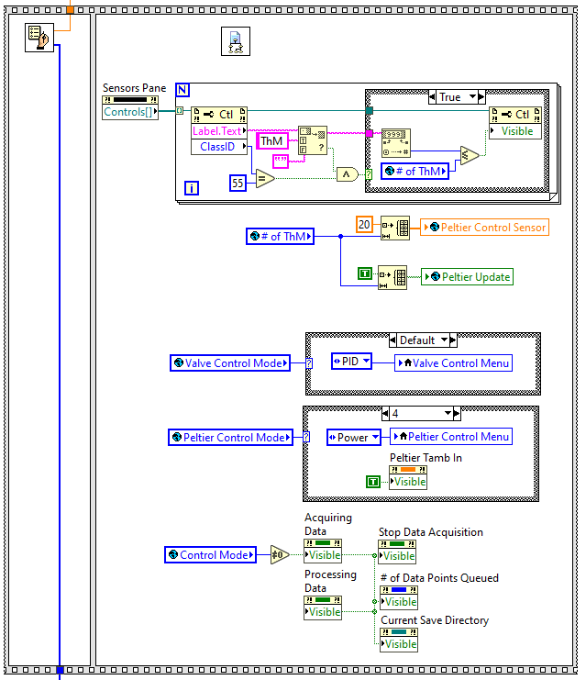
Structure
Sequence Structure 1
sub_get user input.vi
sub_process channels.vi
Initializes the global variable used to tell the Peltier sub-vis a change has been made to the control values
Controls the number of visible display tabs in the main vi, based on the number of ThM
Initializes the global variable used to store the current Peltier control sensor values
Changes the control pane display based on the valve control mode
Changes the control pane display based on the Peltier control mode
Hides some of the control pane components if debug mode is chosen

Slide 25
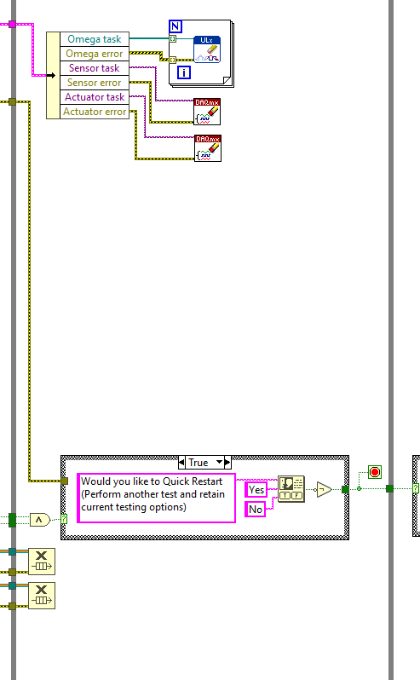
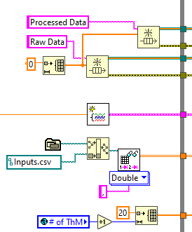
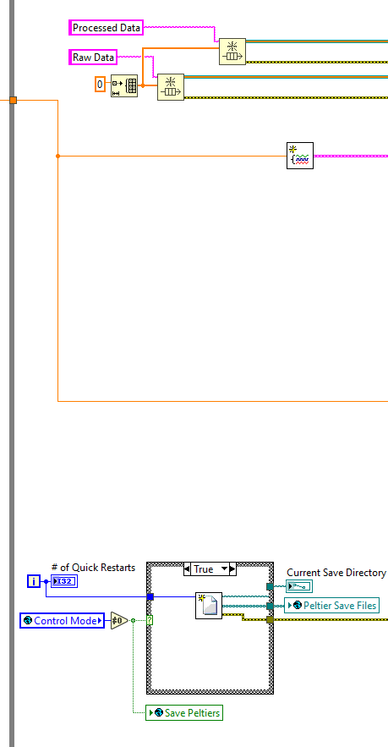
Structure
While Loop 2
Ends all the tasks used to collect data from the Omega DAQs
Creates queues to hold the raw and processed data before it is saved
Ends the task used to collect data from the NI DAQ
sub_create tasks.vi
Loads the inputs file
Ends the task used to control the valves
Initializes the shift register that stores the ambient and thermal mass temperatures for use in the actuator control
Displays message to user and either restarts or terminates this loop
sub_create save files.vi
Creates save files if debug mode is not selected
Deletes the queue after the data collection is over

Slide 26
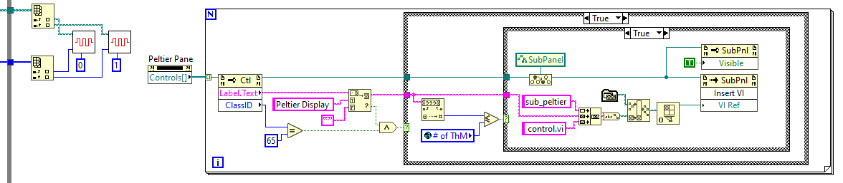
Structure
While Loop 3
Finds the appropriate subpanels in the Peltier Pane and either inserts the matching subvi or makes it invisible based on the number of thermal masses
sub_peltier 1 control.vi
sub_peltier 2 control.vi

Slide 27
Structure
While Loop 4 Part 1
Processes data, and when not in debug mode, adds data to the queue
Displays time limit and elapsed time & calculate if time has elapsed
sub_run actuators.vi
Displays current values in the GUI
sub_process data.vi
sub_collect data.vi
Ends loop if 1) button is pressed, 2) time elapses, or 3&4) an error occurs
Shift register stores which command column to execute
Checks for error, by looking for a large amount of data collected immediately

Slide 28
Structure
While Loop 4 Part 2
Stores ambient and thermal mass temperatures for use in the actuator control
Converts update rates from seconds to iterations
Stores and displays Peltier values based on which control mode is selected
Displays warning if supply temp exceeds 90°C
Stores and displays Peltier values based on which control mode is selected
Stores “Run” & “Go” Button actions in global variables
Changes control pane display settings
Stores PID gains in global variable

Slide 29
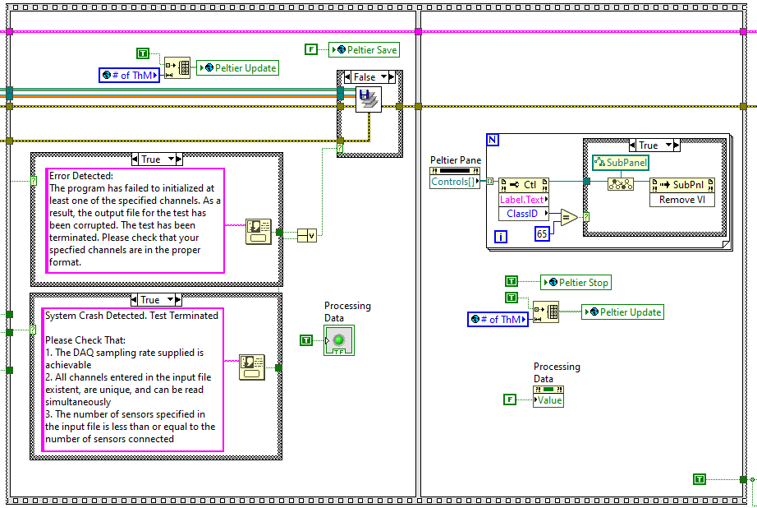
Structure
Sequence Structure 2
Saves data if no error occurred
sub_save output files.vi
Stops saving Peltier values
Displays if an error occurred
Removes the Peltier sub-vis from the subpanels
Changes control pane display settings
Ends the Peltier controller sub-vis
Ends While Loop 3

Slide 30
Global Variables
Name | Type | Description | Write location
# of sensors | Long | # of rows to be taken from Channels.csv | sub_acquire user input
# of ThM | Long | # of Thermal Masses | sub_acquire user input
# of USB DAQ | Long | # of Omega DAQs to be added to task | sub_acquire user input
Control Mode | Long | Control mode (see slide XX) | sub_acquire user input
Timer Length | Double | Timer length for timed mode | sub_acquire user input
File Name | String | Name for save folder | sub_acquire user input
Path | File Path | Path for new save folder | sub_acquire user input
Sensor Descriptions | 2D array of String | Parameter, Unit, DAQ Channel, & Sensor Type taken from Channels.csv | sub_process channels
Sensor Labels | 2D array of Long | Calibration Type and GUI Output # taken from Channels.csv | sub_process channels
Voltage Limits | 2D array of Double | Upper and Lower Voltage Limits taken from Channels.csv | sub_process channels
Sources | 1D array of Long | DAQ Type for each sensor, 1 for Omega, 0 for NI | sub_create tasks

Slide 31
Global Variables
Name | Type | Description | Write location
Calibration Table | 2D array of Double | Calibration values taken from Calibration.csv | For Loop 1
Valve Control Mode | Word | Valve control mode (see slide XX) | sub_acquire user input
Valve New Value | Boolean | Update Valve, from “Run” button | Main GUI
Valve Position | 1D array of Double | Desired Valve position (%) | Main sub_run actuators
Valve Set Temp | 1D array of Double | ThM Temperature setpoints for PID Valve Control | Main GUI sub_run actuators
Valve Gains | 1 D array of Cluster of 3 Double | Gains for PID control of Valves | Main GUI
Valve Update Rate | Long | How often the valve position is updated | Main GUI

Slide 32
Global Variables
Name | Type | Description | Write location
Peltier Control Mode | Word | Peltier control mode (see slide XX) | sub_acquire user input
Peltier New Value | Boolean | Update Peltiers, from “Go” button | Main GUI
Peltier Set Temp | 1D array of Double | Cold side temperature setpoints for Peltier Junctions | Main GUI sub_run actuators
Peltier Set Power | 1D array of Double | Power setpoints for Peltier Junctions | Main GUI sub_run actuators
Peltier Control Sensor | 1D array of Double | Current cold side temperature measurement | Main GUI sub_peltier control
Peltier Update Rate | long | How often the Peltier controller is updated | Main GUI

Slide 33
Global Variables
Name | Type | Description | Write location
Peltier Save | Boolean | Save Peltier data to file | Main GUI sub_peltier control
Peltier Stop | Boolean | End execution of the Peltier sub-vis | Main GUI
Peltier Update | 1D array of Boolean | Indicates when a Peltier global variable value has changed so the Peltier control sub-vis can check them | Main GUI sub_run actuators
Peltier Tamb | Double | Simulated ambient temperature for Tamb control of Peltiers | Main GUI Sub_run actuators

Slide 34
Adding Additional Components
Currently, the code is configured to accommodate 4 thermal masses, 2 Peltier junctions, and 2 control valves
While it easy to add the sensors for the 3rd and 4th thermal mass (see below), follow the instructions to add the valves and Peltier junctions associated with these thermal masses
Adding a 3rd & 4th Thermal Mass
GUI: The code is already setup to display data for a 3rd & 4th thermal mass, the only required change is to rearrange the tabs used to display the data. The ThM 3 & ThM 4 tab can be placed in between the Source tab and the ThM 2 tab.
Block Diagram: No changes needed.
Sensor: Add the sensor to the channels file. Use the file “DistrictHeatingNetwork/Sensor Information/Sensor Locations.xlsx” to fill in the GUI Output #.
Additional instructions are also included to add thermal masses beyond the 4 the code is currently configured to handle.

Slide 35
Adding Additional Thermal Masses
GUI:
Duplicate the ThM 2 tab, ensure the new tab control has a name of the form “ThM #”, and all variables.
Rearrange the tabs so they match the lab’s configuration. ThM 1 should always be the last display as that tab contains fewer sensors and a different pipe diagram.
Main Block Diagram:
Displaying the data: Adding the new tab will create terminals in the block diagram. Add additional cases the to the case structure used display current values in the GUI in While Loop 4. Put the variables in new cases, recording the variable/case # pairs in the file “DistrictHeatingNetwork/Sensor Information/Sensor Locations.xlsx.”
Sub Vis:
sub_get user input: increase the upper limit on the number of thermal masses error to the appropriate value
Sensors:
Use the variable/case # pairs to populated the GUI Output # in the Channels file
Each additional thermal mass requires 8 TM, 4 PS, and 2 MS to be fully observable

Slide 36
Adding Peltier Junctions
GUI:
Add additional subpanels to the left pane in the main GUI. Make sure it is labeled “Peltier Control #”.
Peltier Control Menu tab control:
Manual tab: Add additional elements to the control array
Timed tab: Add additional elements to the indicator array
Power tab: Add additional elements to the Power Setpoint control array. Add additional elements to the Control Temp indicator array.
Main Block Diagram: No changes needed
Sub Vis:
Sub_peltier control #: Create 1 copy of “sub_peltier control 1.vi” for each new Peltier junction and name it “sub_peltier control #.vi”, with the number correlating to its respective thermal mass.
Sub_run actuators.vi: Additional rows will have to be added to the Inputs.csv file for each additional Peltier junction. Doing this will change the indexing for the control inputs. There are 6 total to update. Each corresponds to a different timed control mode and are found in the odd # cases in both structures.
Sensors: Currently the Peltier controller is configured to have 2 10K control thermistors. This can be changed manually by changing the default values in the front panel of the new sub vi.
Inputs.csv: Add additional rows to the file, keeping them grouped by input type. Add one row for each Peltier Junction to the “Cold Side Temp”, and “Power” sections. Only 1 Tamb row is needed for all Peltier junctions. Additionally, add more rows for the heat transfer coefficients of each thermal mass.

Slide 37
Adding Control Valves
GUI:
Valve Control Menu tab control:
Manual tab: Add additional elements to the control array
Timed tab: Add additional elements to the indicator array
Power tab: Add additional elements to the Temp Setpoint control array, Valve Position indicator array, and PID cluster array.
Main Block Diagram
If more than 4 valves are being used, add additional cases to the case structure in While Loop 4 use in the PID control of the valves. Add local variables referencing the appropriate thermal mass temperatures.
Sub Vis:
Sub_create tasks.vi: add additional channels for each new valve, in the appropriate form, separated by commas to the I/O constant used to populate the physical channels of the actuator task.
Sub_run actuators.vi: Additional rows will have to be added to the Inputs.csv file for each additional valve. Doing this will change the indexing for the control inputs. There are 6 total to update. Each corresponds to a different timed control mode and are found in the odd # cases in both structures.
Inputs.csv: Add additional rows to the file, keeping them grouped by input type. Add one row for each valve to the “Position”, and “PID Setpoint” sections.

Slide 38
Summary
There are 11 custom sub-Vis created to perform various operations during the code’s execution. Their functions and structure will be presented in this section.
The 11 sub-Vis are:
sub_calibrate sensor data.vi
sub_collect data.vi
sub_ create save files.vi
sub_create tasks.vi
sub_get user input.vi
sub_ omega tasks.vi
sub_ process channels.vi
sub_ process data.vi
sub_ process data no queue.vi
sub_ run actuators.vi
sub_ save output files.vi

Slide 39

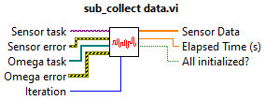
Function
sub_calibrate sensor data.vi
Icon:
Description:
Converts sensor data from voltage to calibrated values, based on the Calibration.csv file
Variables:
Inputs: Raw Data: Raw data from a single sensor Sensor Column: Column in the Channels.csv file for the sensor | Outputs: Calibrated Data: Data converted from voltage to appropriate value
sub_collect data.vi
Icon:
Description:
Gets the current sensor readings from the DAQ systems and the current time
Variables:
Inputs: Sensor Task: Task for NI DAQ Sensor Error: Error for NI DAQ Omega task: array of tasks for Omega DAQs Omega error: array of errors for Omega DAQs Iteration: iteration # of While Loop 4 | Outputs: Sensor Data: array of raw voltage data from sensors Elapsed Time (s): Time when data was collected All Initialized?: True if expected number of channels exists

Slide 40


Function
sub_ create save files.vi
Icon:
Description:
Creates the files where the data will eventually be saved
Variables:
Inputs: # of Quick Restarts: number to be appended to file name | Outputs: Save Path: Folder where the data will be stored Peltier Save Files: File names for the created Peltier data files Error out: error from creating these files and folders
sub_create tasks.vi
Icon:
Description:
Creates the tasks used to get the data from the DAQ systems
Variables:
Inputs: DAQ Sample Rate: Frequency for DAQ Sampling | Outputs: Output cluster: cluster of tasks and errors from the NI and Omega DAQ

Slide 41


Function
sub_get user input.vi
Icon:
Description:
Gathers users input needed to control various aspects of the data collection
Variables:
Inputs: None | Outputs: DAQ Sample Rate: Inverse of samples per second Peltier Channels: Array of COM port numbers for Peltier junctions
sub_ omega tasks.vi:
Icon:
Description:
Creates the tasks used to get the data from the appropriate Omega DAQ
Variables:
Inputs: DAQ Channel: channel for the current sensor Omega tasks: array of Omega tasks Omega errors: array of errors associated with Omega Tasks | Outputs: Source Number: # of Omega task for current sensor (1 indexed) Omega tasks out: new array of Omega tasks Omega errors out: new array of errors associated with Omega Tasks

Slide 42

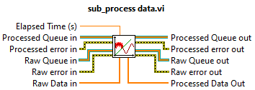
Function
sub_ process channels.vi
Icon:
Description:
Processes the Channels.csv file into global variables
Variables:
Inputs: None | Outputs: None
sub_ process data.vi
Icon:
Description:
Takes the raw data, processes it, and adds it to the appropriate queues
Variables:
Inputs: Elapsed Time: time when data was collected Processed Queue in: queue for processed data Processed error in: error associated with the processed queue Raw Queue in: queue for raw data Raw error in: error associated with the raw queue Raw Data in: 1D array of raw sensor data | Outputs: Processed Queue out: new queue for processed data Processed error out: new error associated with the processed queue Raw Queue out: new queue for raw data Raw error out: new error associated with the raw queue Processed Data Out: 1D array of processed sensor data

Slide 43

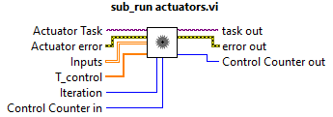
Function
sub_ process data no queue.vi
Icon:
Description:
Takes the raw data and processes it without adding it to the queues
Variables:
Inputs: Elapsed Time: time when data was collected Raw Data: 1D array of raw sensor data | Outputs: Processed Data: 1D array of processed sensor data
sub_ run actuators.vi
Icon:
Description:
Performs the desired actuator tasks based on the current iteration and control mode
Variables:
Inputs: Elapsed Time: time when data was collected Raw Data: 1D array of raw sensor data | Outputs: Processed Data: 1D array of processed sensor data

Slide 44

Function
sub_ save output files.vi
Icon:
Description:
Takes the data from the queues and saves it to the appropriate .csv files
Variables:
Inputs: Raw Queue in: queue for raw data Processed Queue in: queue for processed data Processed Data error: error associated with the processed queue Raw Data error: error associated with the raw queue | Outputs: error out: combined error from saving data

Slide 45
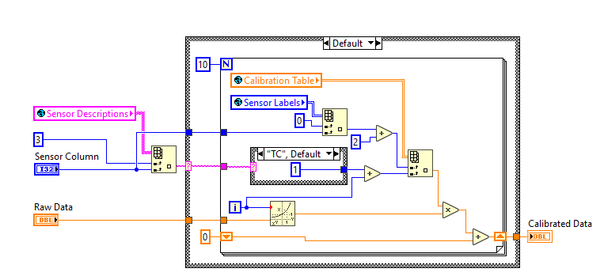
Structure
sub_calibrate sensor data
Starting column in Calibrate.csv
Global Variables with Calibrate.csv data
Row in Calibrate.csv from Channels.csv
Loop through 10 terms
Check the sensor type, TM don’t need calibration
Global Variables with Channels.csv data
Output
Input Variables
Sum up terms
Each loop, raise voltage to increasing power, and increase coefficient column

Slide 46
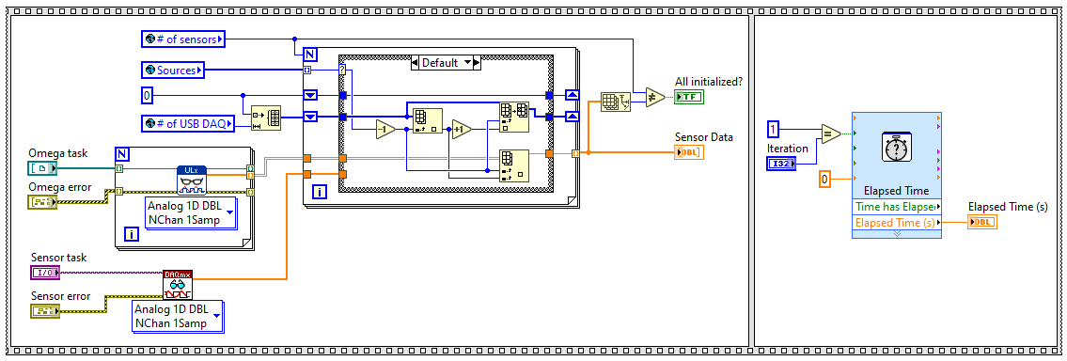
Structure
sub_collect data
Intermingles sensor data from the 2 types of DAQs, where 0 is NI, > 0 is Omega
Ensures all data is collected before the time is recorded
Reads the NI DAQ sensors
Reads the Omega DAQs sensors
Gets the time when the data collection is completed

Slide 47
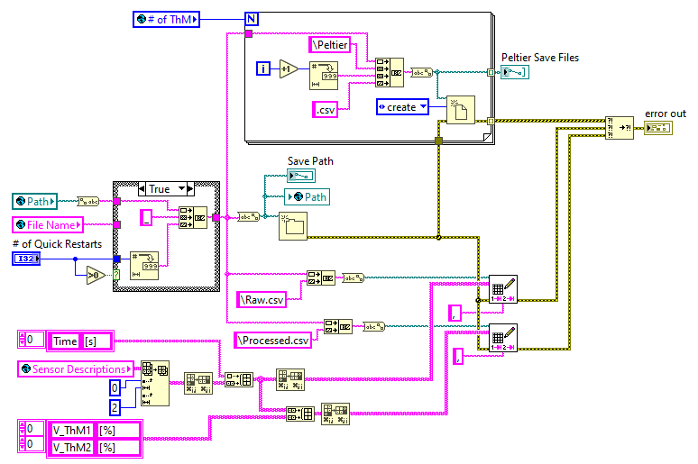
Structure
sub_ create save files
Creates the correct number of Peltier save files
Adds a number to the folder name if a quick restart is requested
Creates the folder
Adds columns for the time and valve positions to the columns created in the channels file
Writes the column headers to the two save files (raw and processed)

Slide 48
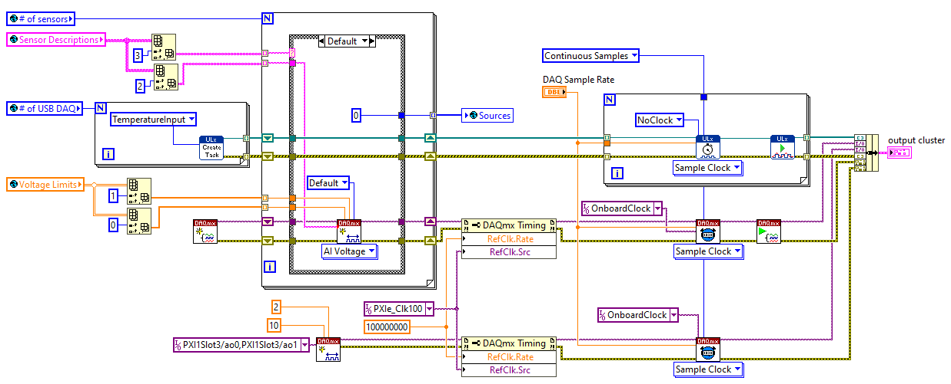
Structure
sub_create tasks
Adds the channel to the appropriate task based on sensor type
Sets no clock for the Omega tasks, since the NI DAQ handles all the timing
Provides the channel settings
Vector of which DAQs each channel belongs to
Clusters all tasks and errors together
Creates tasks for the DAQs
Starts the sensor tasks
Creates output channels for the two valves
Case Structure contains sub_omega tasks.vi to assign the channels for the type “TM”
Sets up the same reference clock for both NI tasks

Slide 49
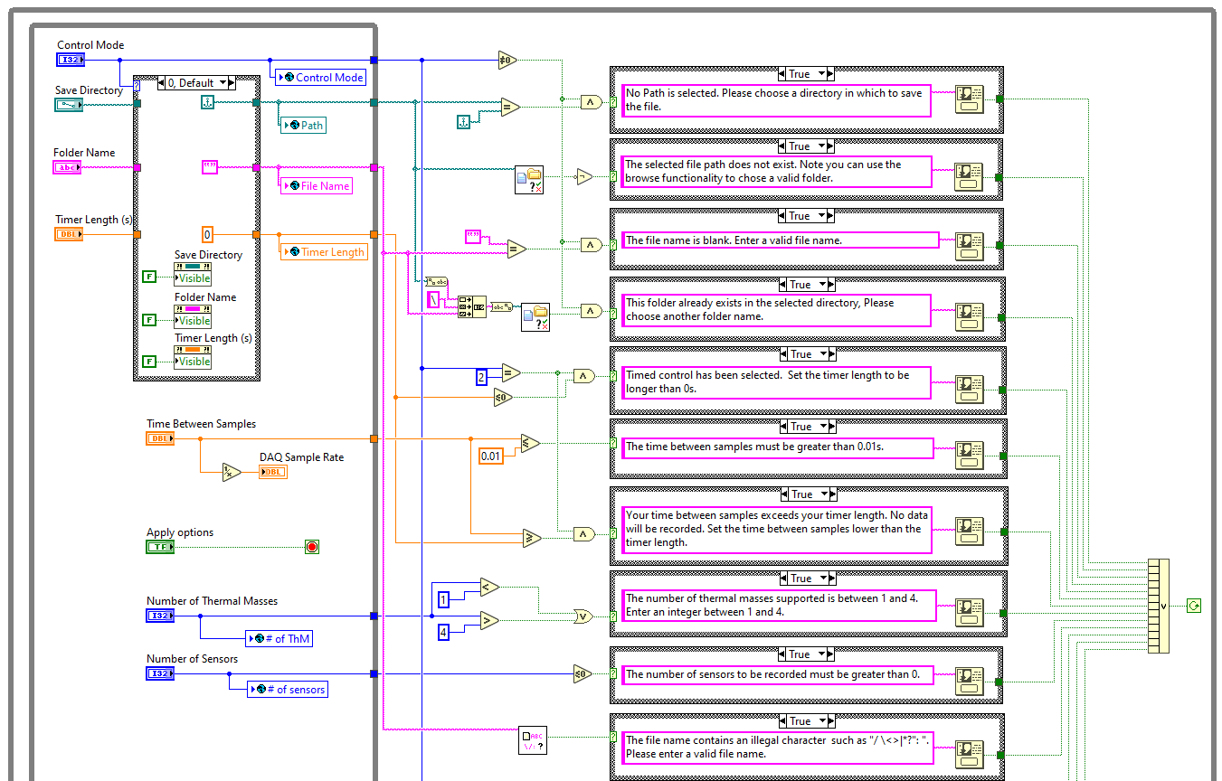
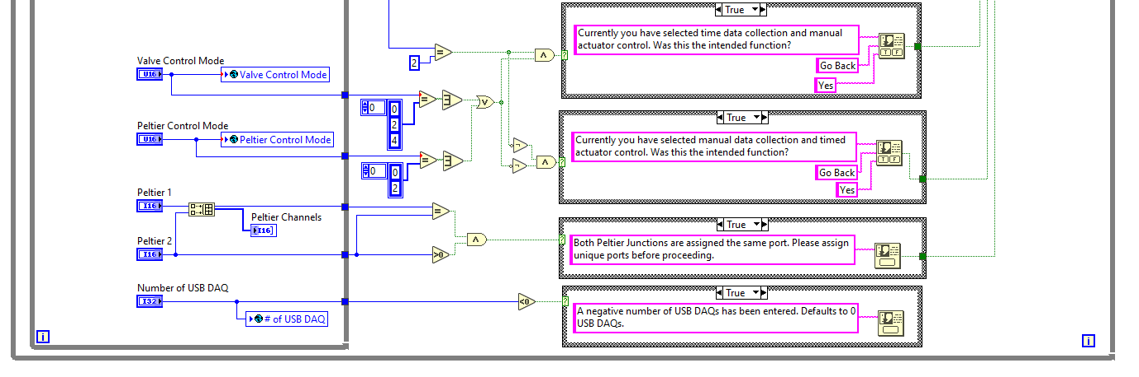
Structure
sub_get user input
Some inputs are not required in certain control modes
While Loop, waits for user to click “Apply Options” before proceeding.
While Loop, exits only if none of the errors are triggered.
Stores variables in global variables & indicators
User inputs, Details can be found in “Quick Start – User Inputs”
Error checks

Slide 50
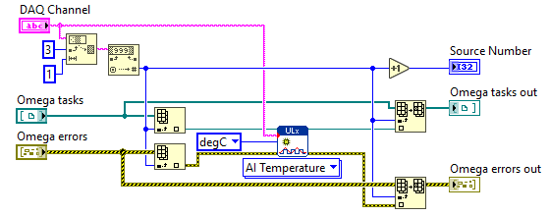
Structure
sub_ omega tasks
Extracts the DAQ # from the channel name
Creates the channel
Gets the correct task and error
Adds the new task and error back in

Slide 51
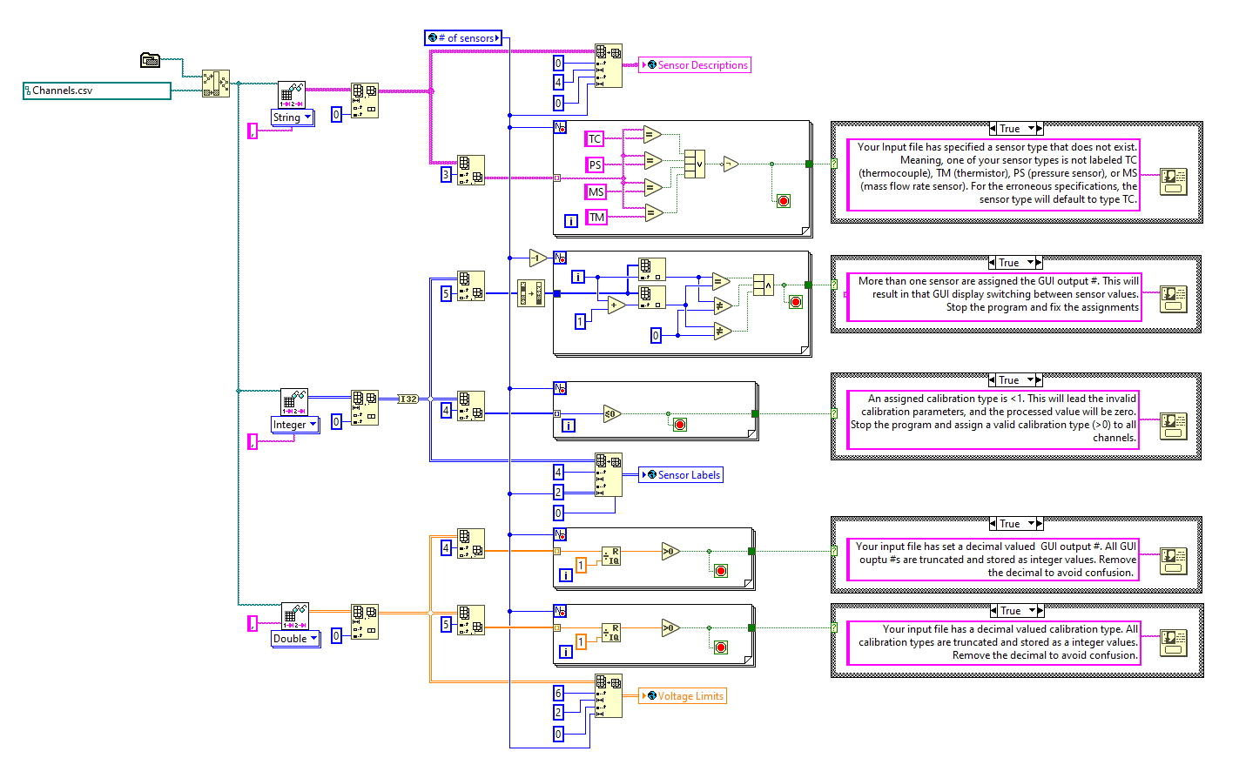
Structure
sub_ process channels
Error checks, purpose explained in corresponding warnings
Path for the Channels file
Stores components in global variables
Loads data with different types specified
Warning Messages to user, code keeps running

Slide 52
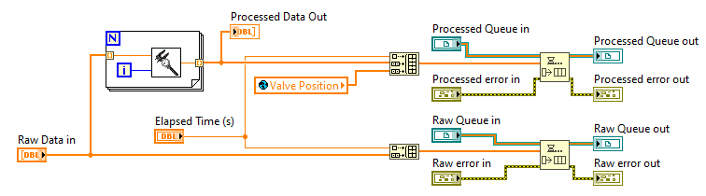
Structure
sub_ process data
Appends valve position and time to processed data
sub_calibrate sensor data.vi
Adds data to appropriate queue
Processes all elements of raw data array
Appends time to raw data

Slide 53
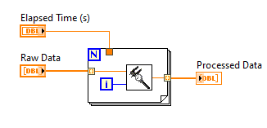
Structure
sub_ process data no queue
Ensures time is available before beginning processing
sub_calibrate sensor data.vi
Processes all elements of raw data array

Slide 54
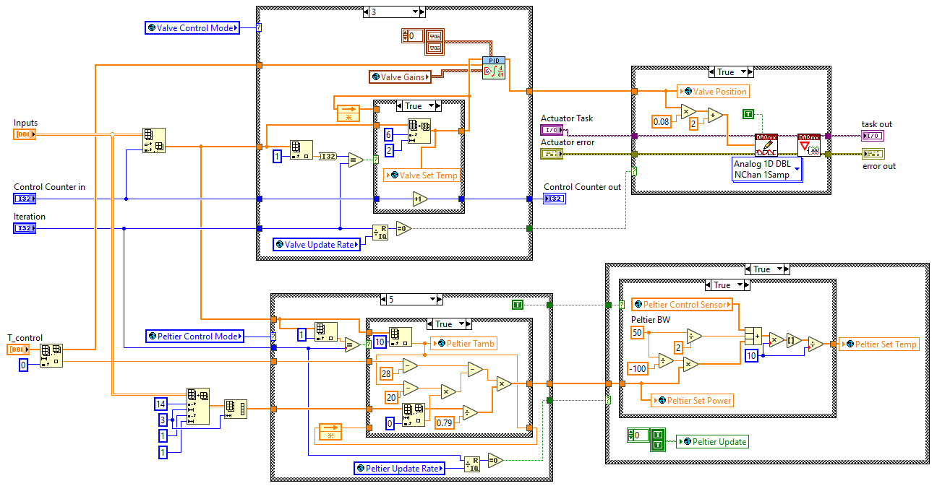
Structure
sub_ run actuators
Valve control case structure
Sends voltage command to valves task
Selects cases based on user inputted control modes
Converts from power to cold side temperature if true
Ambient and Thermal Mass temperatures
Passes calculated control input to Peltier controllers
Thermal mass characteristics
Peltier control case structure

Slide 55
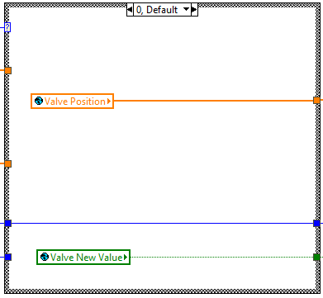
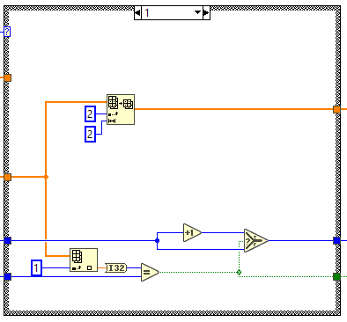
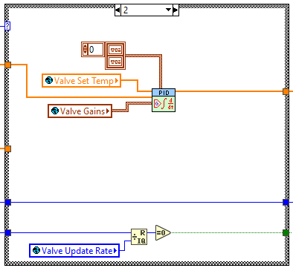
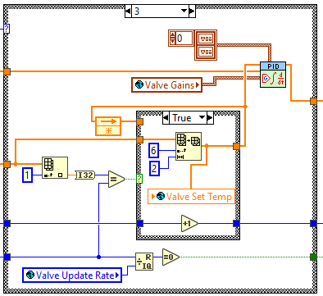
Structure
Sub_Run Actuators (Valve Cases)
Takes position from inputs file
Increments counter if a new input is ran
Takes manually entered values directly
Updates valve position if iteration # matches input file
PID with setpoints entered manually
Updates PID setpoint if iteration # match, otherwise uses old value
PID with setpoints from input file
Checks if the valve control should update

Slide 56
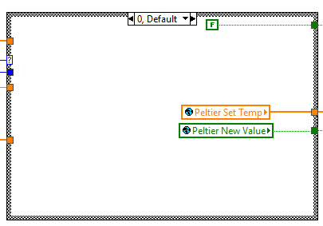
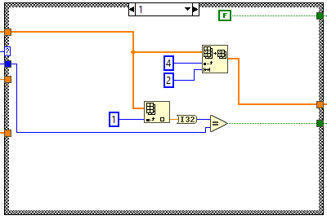
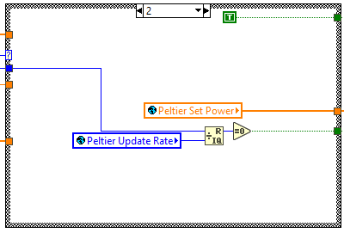
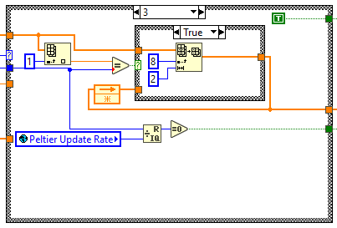
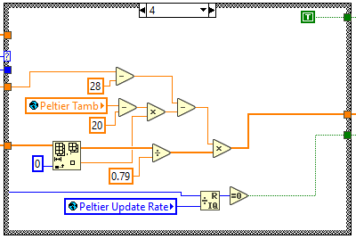
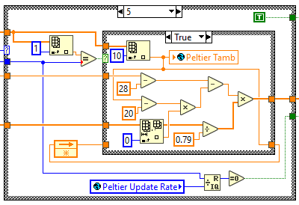
Structure
Sub_Run Actuators (Peltier Cases)
Takes cold side temp from inputs file
Takes manually entered power values directly
Takes manually entered cold side values directly
Updates Peltier if iteration # matches input file
Updates power setpoints from inputs file if iteration # match, otherwise uses old values
Checks if the Peltier control should update
Calculates power from manually entered simulate ambient temperature
Calculates power from simulate ambient temperature, either from inputs file, if iteration # matches, or from old value

Slide 57
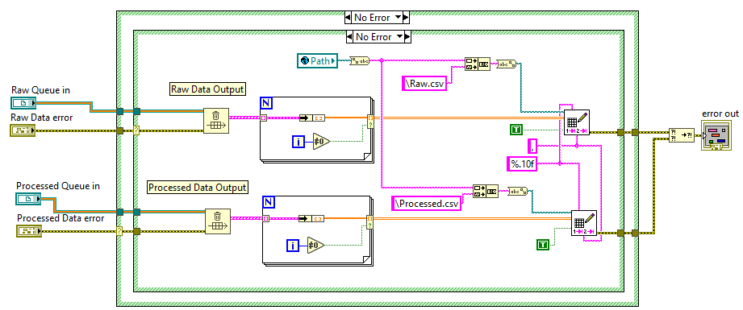
Structure
sub_ save output files
Removes external cluster holder from 1D array of data, skipping the 1st value
Flushes all data from the queues
Appends data to the pre-created files, given by the global variable path

Slide 58
Introduction
The Peltier controllers are communicated with using the sub vis “sub_peltier # control” where each sub vi interacts with one Peltier controller. These vis pass information to the controller and receives information from the controller and displays it. It also records the data.
To operate the controllers, the project files and library of subvis must be in the same folder as the main sub vi.
To ensure the GUI displays properly in the main vi, shrink the window to fit the Display tab, and save it centered around this tab

Slide 59
Introduction
This code was modified from the code provided by TE Technology. The main changes are:
The code was simplified, cleaned up, and redundant elements were removed. This makes troubleshooting easier and adapts the code to run as a subvi.
The main GUI was changed to make it easier to display in the subpanel.
The control cluster was changed to add the End and Final Loop variables, and some extraneous variables were removed.
The Stop and Quit LabVEIW commands were also removed in the original code, replaced by a variable that will end the main for loop and allow the code to stop running.
The Stop and Quit LabVIEW commands were also eliminated in the sub vis. They were replaced with outputs that could be used to modify the End variable’s state
Global variables were added to allow real time communication with the main VI.
All hidden variables on the main vi were either removed or made visible.
The ability to download configurations was removed, as this was poorly implemented and not used on our experiments.
Additional information was added to the error messages to make troubleshooting easier

Slide 60
GUI Components
The GUI has 5 tab controls that group the variables. The categories are:
Display: Displays relevant data to the user.
Misc Settings: Settings and outputs from the code. None of these should be modified unless, changes are made to the Peltier junction.
Graph Data: Data stored to be used in the graph and to set the Peltier controller.
Alarm Settings: Settings to configure alarms. No alarms have been used, and this code has not been tested. See manual for details on the variables meanings and operation.
Controller Settings: Settings for how the power is calculated based on the set cold side temperature. These must be set differently, depending on the Peltier control mode See manual for more details on how the PID control is implemented.

Slide 61
GUI Components- Misc Settings
Name | Type | Description | Default Value
Sensor Type | Radio Button | Type of thermistor connected to the Peltier controller | 10K
Output Polarity | Radio Button | Configures the Peltier junction to either heat or cool | Cool
Temperature 2 Display | Radio Button | Indicates if a second thermistors connected to the Peltier controller | On
CRC Error | Boolean | Indicates if a CRC error occurs during code execution | -
EEPROM Write Enable | Boolean | If true, the controller remembers its settings even after power to the controller has been turned off. See manual for more details | False
Firmware Version | String | Displays the firmware version read from the controller | -
Analog Output Multiplier | Double | Scales the maximum voltage that can be supplied to the Peltier Junction | 1
Reading Configuration | Single | Displays the progress of the configuration of the Peltier controller as a % | -
Error out | Error | Displays the error cluster as the code runs | -

Slide 62
GUI Components- Graph Data
Name | Type | Description
Set Temperature | Double | Set temperature to be communicated to the controller
Control Sensor | Double | Displays Sensor 1 value
Input 2 Sensor | Double | Displays Sensor 2 value
Elapsed Time | Double | Start time minus current time, used when storing the data in the save file
Sample in Time | Time Stamp | Current time
Start Sample Time | Time Stamp | When the data started being recorded

Slide 63
GUI Components- Control Settings
Name | Type | Description | Power Control Value | Cold Side Control Value
Set Limit High | Double | Maximum possible set temperature | 100 | 70
Set Limit Low | Double | Minimum possible set temperature | -20 | -20
Control Sensor Offset | Double | Offsets the control sensor reading by this amount for display and control calculations | 0 | 0
Proportional Bandwidth | Double | Temperature span over which the power is proportioned from 100% to 0% power, centered about the temperature set point. | 50 | 5
Integral Gain | Double | Shifts the proportional bandwidth to correct for offsets | 0 | 1
Derivative Gain | Double | Shifts the proportional bandwidth based on the change in the error | 0 | 0
Sample Rate (s) | Integer | Sets how often the data is collected | 1 | 1

Slide 64
Structure
While Loop 1 sets up communication with controller based on COM variable. Changes end to true if an error occurs.
Error 1 displays error message and restarts While Loop 1 if user selects “restart”, ends it if user selects “exit,” or no error occurs
While Loop 2 executes while the Peltier controller is running. It updates Peltier variables if values of the relevant global variables change. Exits if the End variable is true. Updates the values of the control cluster base on outputs from Case Structure 2. Displays the error variable and the CRC error Boolean.
Sequence Structure 1 initializes connection with Peltier controller.
Error 2 displays an error message if an error occurs during Sequence Structure 1. Either sets the control cluster to restart or end.
Sequence Structure 2 performs ordered tasks associated with the continued operation of the Peltier controller. Contained in an error case, so only executes if no error is present
Pane 1 tries to communicate with the Peltier controller. Executes if Read Model is true. Gets and displays the firmware version. Ends loop if the controller connects, if a CRC error is detected, or if it tries more than 3 times. Contained in an error case, so only executes if no error is present
Pane 2 loops through settings to initialize them. Executes if Read Settings is true. Ends once all 21 settings have been configured. Contained in an error case, so only executes if no error is present
Pane 1 checks alarm status and blinks Alarm light if the alarm value is in range. Set Read Settings to true if necessary.
Pane 2 reads the cold side temperature, inputs 1 & 2 (if necessary), displays them and puts them in an array.
Pane 3 displays the values in the strip chart if no error has occurred. Reads the current time.
Pane 4 reads and displays the power output and adds it to the data array.
Pane 5 saves the data to the file. Creates the header if the file is empty. Calculates elapsed time.
Case Structure 2 reads the set temperature from the controller and Input 2 if set to.
Case Structure 3 reads Input 1 sensor and saves it as in a global variable.
Error 4 displays an error message if an error occurs during While Loop 2. Either sets the control cluster to restart or end.
Event Structure 1 updates the controller if any changes are made to the setting. Contained in an error case, so only executes if no error is present
Case Structure 1 displays error message if CRC Error is true and either sets the control cluster to restart or end. Otherwise passes the control cluster unchanged.
Error 3 displays an error message if an error occurs during While Loop 2. Either sets the control cluster to restart or end.

Slide 65
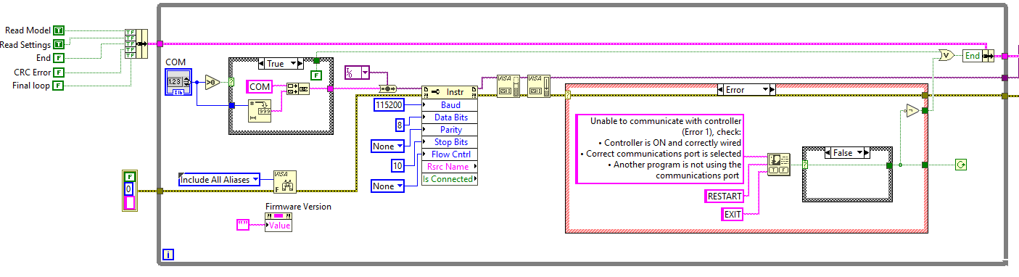
Structure
While Loop 1
Control cluster that holds variables to indicate what tasks must be performed
Sets end to true if COM port number is zero or negative
Sets communication port #
Initializes error
Connects with Peltier controller port
Error 1 pauses then re-runs loop if an error occurred and user selected “restart”. Sets end to true if user selects “Exit.” Ends loop if no error occurred

Slide 66
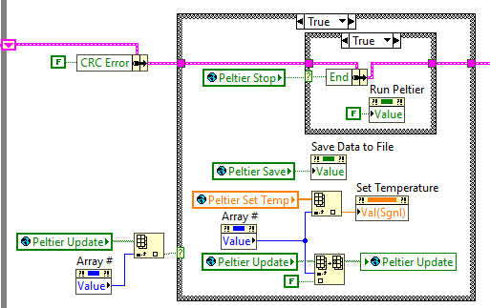
Structure
While Loop 2
Resets the CRC Error value
If the global variable says to end the code, the run Peltier button is set to false to turn of the controller power
If a global variable is updated, the updated value is assigned to the appropriate local variable
Values stored in arrays so array # is used to index
Once the update is applied, need to update variable is set to false

Slide 67
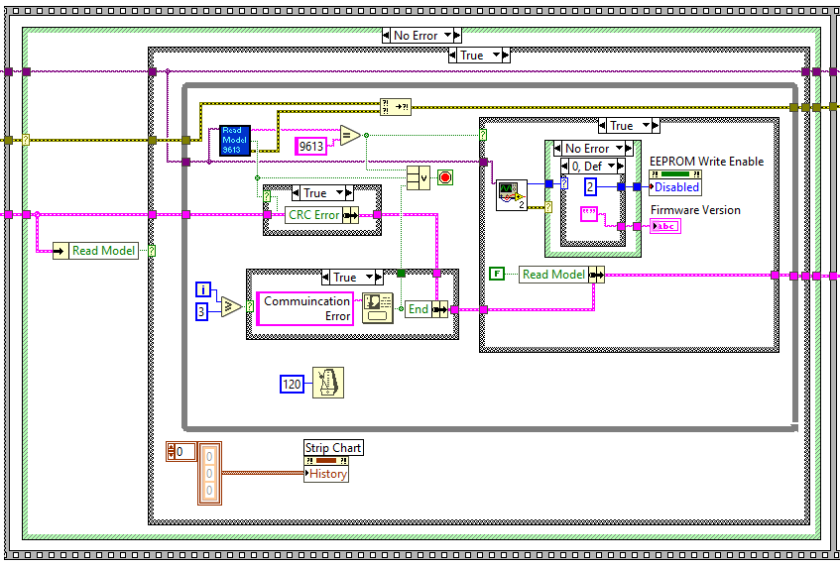
Structure
Sequence Structure 1 Pane 1
Ends loop if it connects correctly, a CRC error occurs, or it tries 3 times
Does not execute if an error occurs
Gets and displays firmware version from controller
Reads information from the controller
Executes if Read Model is true
Clears strip chart history
Tries to connect 3 times before ending the codes execution

Slide 68

Structure
Sequence Structure 1 Pane 2
Loops through 21 settings
Does not execute if an error occurs
Performs action and saves value in appropriate local variable
Executes if Read Settings is true
Displays progress of configuration
Settings have now been read
Changes if a CRC error occurs or an error occurs that requires ending the execution

Slide 69

Structure
Error 2
Sets code to reconfigure model and settings if an error occurred and user selected “restart”. Sets end to true if user selects “Exit.” Does nothing if no error occurred.
If End is true, code needs to loop through 1 more time to ensure the controller is turned off, if possible. The Final Loop variable ensures this happens

Slide 70

Structure
Sequence Structure 2 Pane 1
Displays if an alarm has occurred
Recheck settings
Checks the controller alarms
Changes if a CRC error occurs or an error occurs that requires ending the execution

Slide 71

Structure
Sequence Structure 2 Pane 2
Only runs if no error has occurred
Turns on sampling indicator
Stores all values in an array
Reads Sensor 1 value
Reads and displays setpoint value
Stores control sensor value in global variable
Reads Sensor 2 value, if available
Changes if a CRC error occurred or an error occurred that requires ending the execution
Changes if a CRC error occurred

Slide 72
Structure
Sequence Structure 2 Pane 3 & 4
Only runs if no error has occurred
Reads output power from controller
Displays sensor values on strip chart, based on how many sensors are available
Adds power to array of values
Turns off sampling indicator
Sets chart limits and labels
Displays output power
Gets current time

Slide 73

Structure
Sequence Structure 2 Pane 5
Only executes if no error has occurred reading the file size
Adds headers if file is empty
Saves array to file
Path is an input of the sub vi
Only executes if data should be saved
Processes current time to elapsed time. This is reset if the code is not saving data and on the first loop
Sets code to reconfigure model and settings if an error occurred and user selected “restart”. Sets end to true if user selects “Exit.” Does nothing if no error occurred.

Slide 74

Structure
Event Structure 1
Sample rate (ms) is used to hold the event structure and control rate of looping. The event structure is held until it is time to increment the data, then a timeout occurs, and the loop continues
Checks for changes in values of control variables. If a change occurs, the event structure communicates the new value to the controller and then performs checks to ensure the value is implemented correctly an no errors/alarms have occurred.
No CRC error if the code cannot execute due to an error
Most cases have error checks, where the code will not execute if an error has occurred
Outputs any CRC errors or End loop commands

Slide 75

Structure
Error 3 & Case Structure 1
Sets code to reconfigure model and settings if an error occurred and user selected “restart”. Sets end to true if user selects “Exit.” Does nothing if no error occurred.
Exits loop if end is ever set to true and the code has had the opportunity to loop through the event structure and stop the controller
Changes the End variable if an error occurred in the event structure
Changes the CRC variable if an error occurred in the event structure
Sets code to reconfigure model and settings if a CRC error occurred and user selected “restart”. Sets end to true if user selects “Exit.” Does nothing if no error occurred.

